Slide 1

COLLECTIONS FRAMEWORK

Slide 2
Collections
Framework:
It is a set of classes and interface that implements commonly reuseable data structure.
Collections:
Collection is a framework that provides an architecture to store and manipulate the group of objects.

Slide 3
Collection can achieve all the operations that you perform on a data such as searching, sorting, insertion, manipulation and deletion.
Collection means a single unit of objects. Java Collections framework provides many interfaces(set,list,queue,dequeue) and classes (Arraylist,Vector,LinkedList,Priority Queue,HashSet,LinkedHashSet,TreeSet).

Slide 4
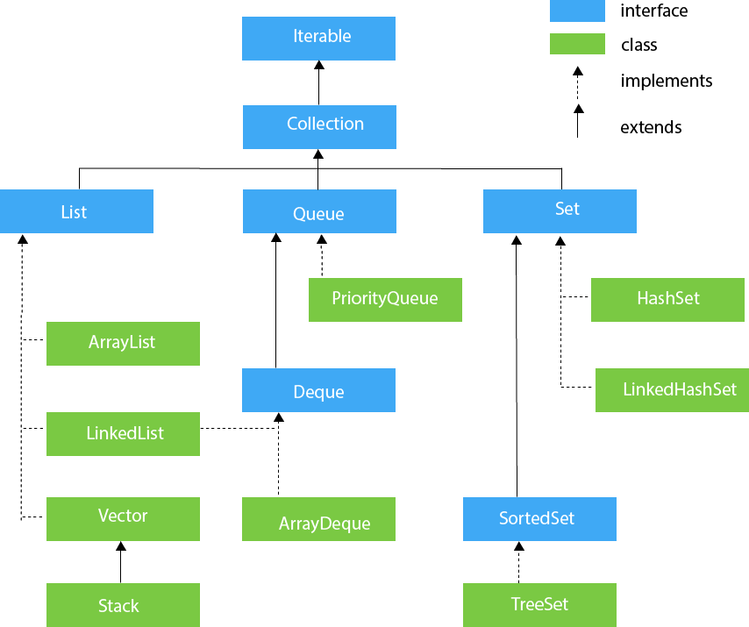
Collection Architecture

Slide 5
LIST
Java ArrayList:
Java ArrayList class uses a dynamic array for storing the elements.
Key points:
1.It contains duplicate elements.
2.It maintains insertion order.
3.Allows random access because array works at the index basis.
4.Manipulation is slow.

Slide 6
1.add()
2.addAll()
3.clear()
4.ensureCapacity()
5.get()
6.isEmpty()
7.lastIndexOf()
8.clone()
9.contains()

Slide 7
10.indexOf()
11.remove()(position(or)value)
12.removeAll()
13.set()
14.trimeToSize()
15.subList()
16.sort()

Slide 8
Java Linked List:
It uses doubly linked list to store the elements.
Key points:
1.It contains duplicate elements.
2.It maintains an insertion order.
3.Manipulation is fast.

Slide 9
Methods:
1.add()
2.addFirst()
3.addLast()
4.clear()
5.clone()
6.contains()
7.addAll()
8.descendingIterator()

Slide 10
9.element()
10.get()
11.getFirst()
12.getLast()
13.indexOf()
14.lastindexOf()
15.offer()
16.offerFirst()
17.offerLast()
18.peek()

Slide 11
19.peekFirst()
20.peekLast()
21.poll()
22.pollFirst()
23.pollLast()
24.pop()
25.push()
26.remove()
27.removeFirst()

Slide 12
SET:
HashSet:
HashSet class is used to create a collection that uses a hash table for storage.
It stores the element by the mechanism called Hashing
Key Points:
1. contains unique elements and accepts null values
2.not maintains insertion order.
3.best for search operation.

Slide 13
1.add()
2.clear()
3.clone()
4.contains()
5.isEmpty()
6.iterator()
7.size()
8.remove()

Slide 14
TreeSet:
It implements the Set interface that uses a tree for storage.
Key points:
1.contains unique elements
2.won’t allow null elements
3.maintains ascending order.
4.access and retrieval times are quiet fast.

Slide 15
1.add()
2.addAll()
3.size()
4.ceiling()
5.floor()
6.higher()
7.lower()
8.pollFirst()
9.pollLast()

Slide 16
10.first()
11.last()
12.contains()
13.remove()
14.clear()
15.isEmpty()
16.clone()
17.Iterator
descendingIterator()
iterator()

Slide 17
18.NavigableSet
descendingSet()
headSet()
subSet()
tailSet()
19.Sortedset
headSet()
subSet()
tailSet()

Slide 18
QUEUE
Queue Interface order the element in FIFO manner. In FIFO, first element is removed first and last element is removed at last.
Priority Queue:
The PriorityQueue class provides the facility of using queue. But it does not orders the elements in FIFO manner.

Slide 19
1.add()
2.offer()
3.remove()
4.poll()
5.element()
6.peek()

Slide 20
DEQUE
It is a linear collection that supports element insertion and removal at both ends. Deque is an acronym for "double ended queue".
Array Deque:
1.add and removal at both the ends
2.don’t allow null elements
3.it has no capacity restriction
4.array deque is faster then linkedlist

Slide 21
1.add()
2.offer()
3.remove()
4.poll()
5.element()
6.peek()

Slide 22
Map Interface
A map contains values on the basis of key, i.e. key and value pair.
Each key and value pair is known as an entry. A Map contains unique keys.
A Map is useful if you have to search, update or delete elements on the basis of a key.
A Map doesn't allow duplicate keys, but you can have duplicate values.

Slide 23
Methods:
1.put()
2.putIfAbsent()
3.putAll()
4.isEmpty()
5.entrySet()
6.keySet()
7.replace()
8.clear()

Slide 24
9.remove()
10.containsValue()
11.containsKey()
12.equals()
13.hashCode()
14.size()

Slide 25
Map.Entry Interface
Entry is the sub interface of Map. It returns a collection-view of the map. It provides methods to get key and value.
1.getKey()
2.getValue()
3.hashCode()
4.setValue()
5.boolean equals()

Slide 26
6.static <K extends Comparable<? super K>,V>Comparator<Map.Entry <K,V>> comparingByKey()
7.static <K,V> Comparator<Map.Entry<K,V>> comparingByKey (Comparator<? super K> cmp)
8.static <K,V extends Comparable<? super V>> Comparator<Map.Entry <K,V>> comparingByValue()
9.static <K,V> Comparator<Map.Entry<K,V>> comparingByValue (Comparator<? super V> cmp)

Slide 27
HashMap:
HashMap class implements the map interface by using a hash table.
Key Points:
1.contains values based on the key.
2.contains only unique elements.
3.may have one null key and multiple null values.
4.maintains no order.

Slide 28
1.void clear()
2.boolean isEmpty()
3.Object clone()
4.Set entrySet()
5.Set keySet()
6.put(Object key, Object value)
7.void putAll(Map map)
8.putIfAbsent(K key, V value)
9.remove(Object key)
10.boolean remove(Object key, Object value)
11.boolean containsValue(Object value)
12.boolean containsKey(Object key)

Slide 29
13.boolean equals(Object o)
14.void forEach(BiConsumer<? super K,? super V> action)
15.get(Object key)
16.getOrDefault(Object key, V defaultValue)
17.boolean isEmpty()
18.replace(K key, V value)
19.boolean replace(K key, V oldValue, V newValue)
20.void replaceAll(BiFunction<? super K,? super V,? extends V> function)
21.Collection values()
22.int size()

Slide 30
LinkedHashMap:
It is Hashtable and Linked list implementation of the Map interface, with predictable iteration order.
Key Points:
1.contains values based on the key.
2.contains unique elements.
3.may have one null key and multiple null values.
4.maintains insertion order.

Slide 31
1.get(Object key)
2.void clear()
3.boolean containsValue(Object value)
4.Set<Map.Entry<K,V>> entrySet()
5.void forEach(BiConsumer<? super K,? super V> action)
6.getOrDefault(Object key, V defaultValue)
7.Set<K> keySet()
8.boolean removeEldestEntry(Map.Entry<K,V> eldest)
9.void replaceAll(BiFunction<? super K,? super V,? extends V> function)
10.Collection<V> values()

Slide 32
TreeMap:
It provides an efficient means of storing key-value pairs in sorted order.
Key Points:
1. contains values based on the key.
2.contains only unique elements.
3.cannot have a null key but can have multiple 4.null values.
5.maintains ascending order.

Slide 33
1.Map.Entry<K,V> ceilingEntry(K key)
2.K ceilingKey(K key)
3.void clear()
4.Object clone()
5.NavigableSet<K> descendingKeySet()
6.NavigableMap<K,V> descendingMap()
7.Map.Entry firstEntry()
8.Map.Entry<K,V> floorEntry(K key)
9.void forEach(BiConsumer<? super K,? super V> action)
10.SortedMap<K,V> headMap(K toKey)
11.NavigableMap<K,V> headMap(K toKey, boolean inclusive)
12.Map.Entry<K,V> higherEntry(K key)
13.K higherKey(K key)

Slide 34
14.Set keySet()
15.Map.Entry<K,V> lastEntry()
16.Map.Entry<K,V> lowerEntry(K key)
17.K lowerKey(K key)
18.NavigableSet<K> navigableKeySet()I
19.Map.Entry<K,V> pollFirstEntry()
20.Map.Entry<K,V> pollLastEntry()
21.V put(K key, V value)
22.void putAll(Map<? extends K,? extends V> map)
23.V replace(K key, V value)
24.boolean replace(K key, V oldValue, V newValue)
25.Collection values()

Slide 35
26.NavigableMap<K,V> subMap(K fromKey, boolean fromInclusive, K toKey, boolean toInclusive)
27.SortedMap<K,V> subMap(K fromKey, K toKey)
28.SortedMap<K,V> tailMap(K fromKey)
29.NavigableMap<K,V> tailMap(K fromKey, boolean inclusive)
30.boolean containsKey(Object key)
31.boolean containsValue(Object value)
32.K firstKey()
33.V get(Object key)
34.K lastKey()
35.V remove(Object key)
36.Set<Map.Entry<K,V>> entrySet()

Slide 36
Hashtable:
It implements a hashtable, which maps keys to values. A Hashtable is an array of a list. Each list is known as a bucket. The position of the bucket is identified by calling the hashcode() method.
Key Points:
contains values based on the key.
contains unique elements.
doesn't allow null key or value.
Java Hashtable class is synchronized.
The initial default capacity of Hashtable class is 11 whereas loadFactor is 0.75.

Slide 37
1.void clear()
2.Object clone()
3.V compute(K key, BiFunction<? super K,? super V,? extends V> remappingFunction)
4.V computeIfAbsent(K key, Function<? super K,? extends V> mappingFunction)
5.V computeIfPresent(K key, BiFunction<? super K,? super V,? extends V> remappingFunction)
6.Enumeration elements()
7.Set<Map.Entry<K,V>> entrySet()

Slide 38
8.boolean equals(Object o)
9.void forEach(BiConsumer<? super K,? super V> action)
10.V getOrDefault(Object key, V defaultValue)
11.int hashCode()
12.Enumeration<K> keys()
13.Set<K> keySet()
14.V merge(K key, V value, BiFunction<? super V,? super V,? extends V> remappingFunction)
15.V put(K key, V value)
16.void putAll(Map<? extends K,? extends V> t))
17.V putIfAbsent(K key, V value)
18.boolean remove(Object key, Object value)

Slide 39
19.V replace(K key, V value)
20.boolean replace(K key, V oldValue, V newValue)
21.void replaceAll(BiFunction<? super K,? super V,? extends V> function)
22.String toString()
23.Collection values()
24.boolean contains(Object value)
25.boolean containsValue(Object value)
26.boolean containsKey(Object key)
27.boolean isEmpty()
28.protected void rehash()
29.V get(Object key)
30.V remove(Object key)
31.int size()

Slide 40
EnumSet:
It is the specialized Set implementation for use with enum types.
Methods:
1.static <E extends Enum<E>> EnumSet<E> allOf(Class<E> elementType)
2.static <E extends Enum<E>> EnumSet<E> copyOf(Collection<E> c)
3.static <E extends Enum<E>> EnumSet<E> noneOf(Class<E> elementType)
4.static <E extends Enum<E>> EnumSet<E> of(E e)
5.static <E extends Enum<E>> EnumSet<E> range(E from, E to)
6.EnumSet<E> clone()

Slide 41
EnumMap:
It is the specialized Map implementation for enum keys.
Methods:
1.clear()
It is used to clear all the mapping from the map.
2.clone()
3.containsKey()
4.containsValue()
5.entrySet()
6.equals()
7.get()
8.hashCode()

Slide 42
9.keySet()
10.size()
11.Values()
12.put()
13.putAll()
14.remove()

Slide 43
Java Comparable interface is used to order the objects of the user-defined class. It contains only one method named compareTo(Object).
positive integer, if the current object is greater than the specified object.
negative integer, if the current object is less than the specified object.
zero, if the current object is equal to the specified object.

